Slide 1
Launching and Marketing
SE495: Software Entrepreneurship

Slide 2
Outline
Launching your software product
Growing your first customer base
Onboarding and retaining customers
Scaling your business
Common challenges and lessons learned

Slide 3
Launching your software product

Slide 4
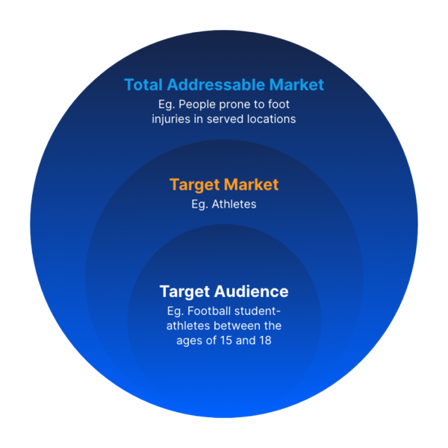
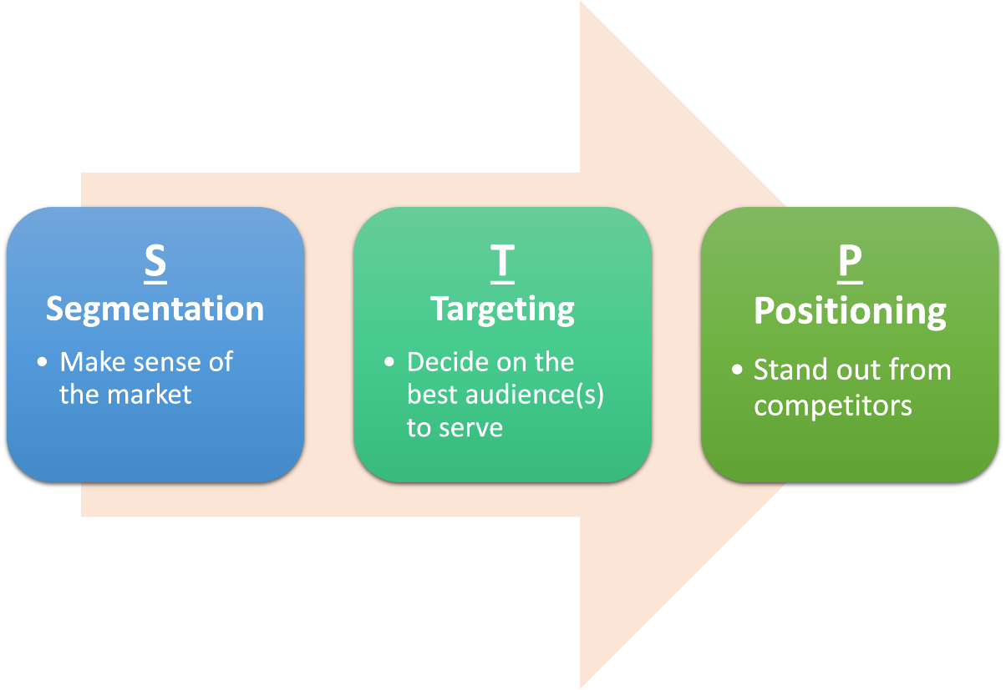
Understanding Your Target Market
Identifying your ideal customer
Understanding their needs, pain points, and motivations
Validating your product-market fit

Slide 5
Defining Your Launch Strategy
Different launch strategies
Soft launch
Launching a product or service to a limited audience in order to get feedback and make improvements before launching to the general public.
Hard launch
Launching a product or service to the general public all at once.
Phased launch
Launching a product or service to different market segments or geographic regions over time.

Slide 6
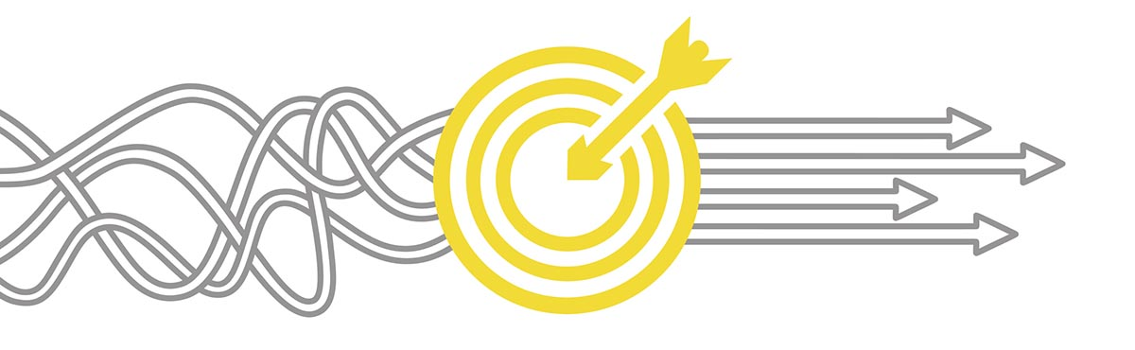
Defining Your Launch Strategy
Factors to consider when choosing a launch strategy
Market conditions
Product complexity and maturity
Competition
Budget and risk
Aligning your launch strategy with your business goals

Slide 7
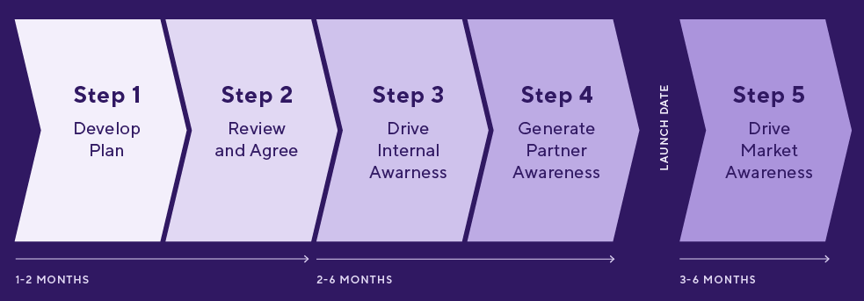
Planning Your Launch Timeline
Creating a timeline for your launch plan
Milestones to include in your timeline (e.g. product development, marketing campaigns, launch date)
Allocating resources and assigning responsibilities

Slide 8
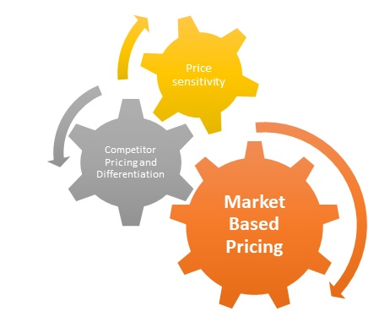
Pricing Your Product/Service
Understanding your pricing options (e.g. freemium, subscription, perpetual license)
Factors to consider when setting your price (e.g. costs, competition, customer perceived value)
Strategies for optimizing your pricing
Price anchoring
Tiered pricing

Slide 9
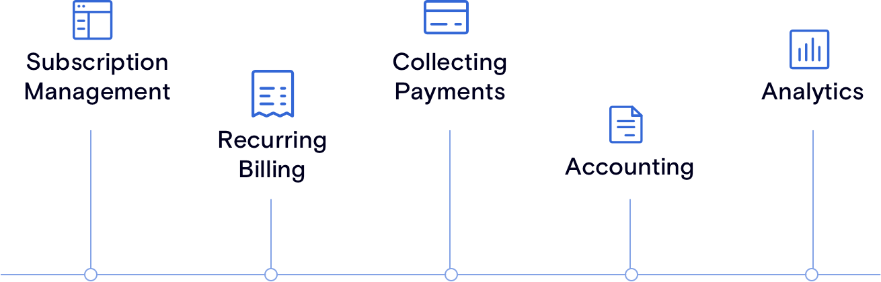
Setting Up Billing/Payment Systems
Different billing and payment systems (e.g. Stripe, PayPal, invoicing)
Factors to consider when choosing a billing/payment system (e.g. security, ease of use, integrations)
Setting up and testing your billing/payment system

Slide 10

Producing Promotional Materials
Different promotional materials (e.g. videos, demos, tutorials)
Factors to consider when creating promotional materials (e.g. target audience, message, production quality)
Best practices for creating effective promotional materials

Slide 11
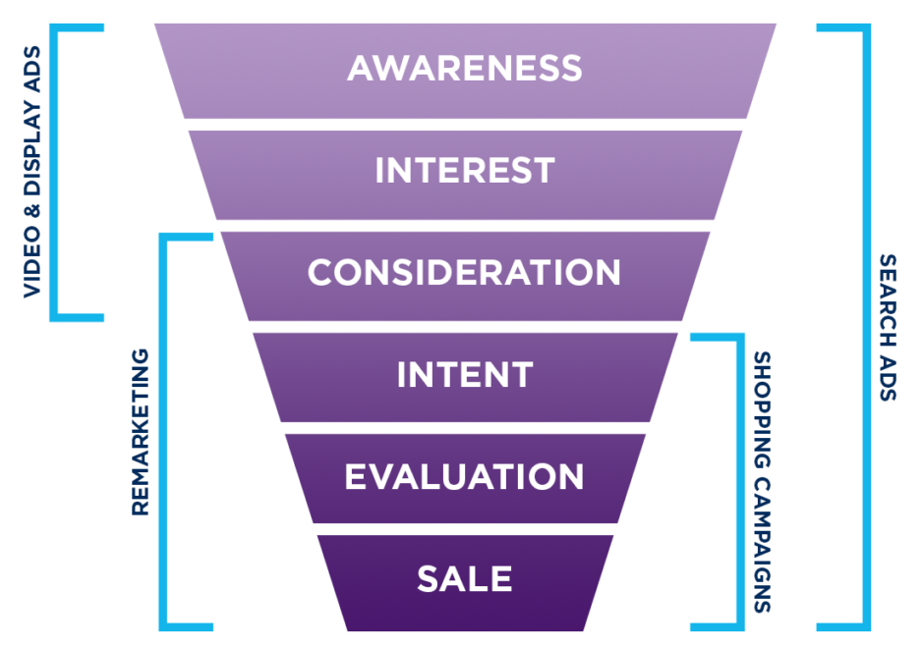
Measuring Launch Success
Defining success metrics for your launch
revenue, user acquisition, customer satisfaction
Analytics and tracking systems to measure success
Strategies for iterating and improving

Slide 12
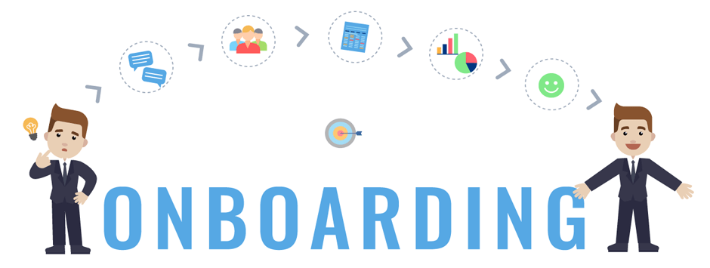
Post-Launch Activities
Customer onboarding
Feedback collection
Upselling/cross-selling
Strategies for maximizing customer lifetime value
Planning for future product development and enhancements

Slide 13
Growing your first customer base

Slide 14
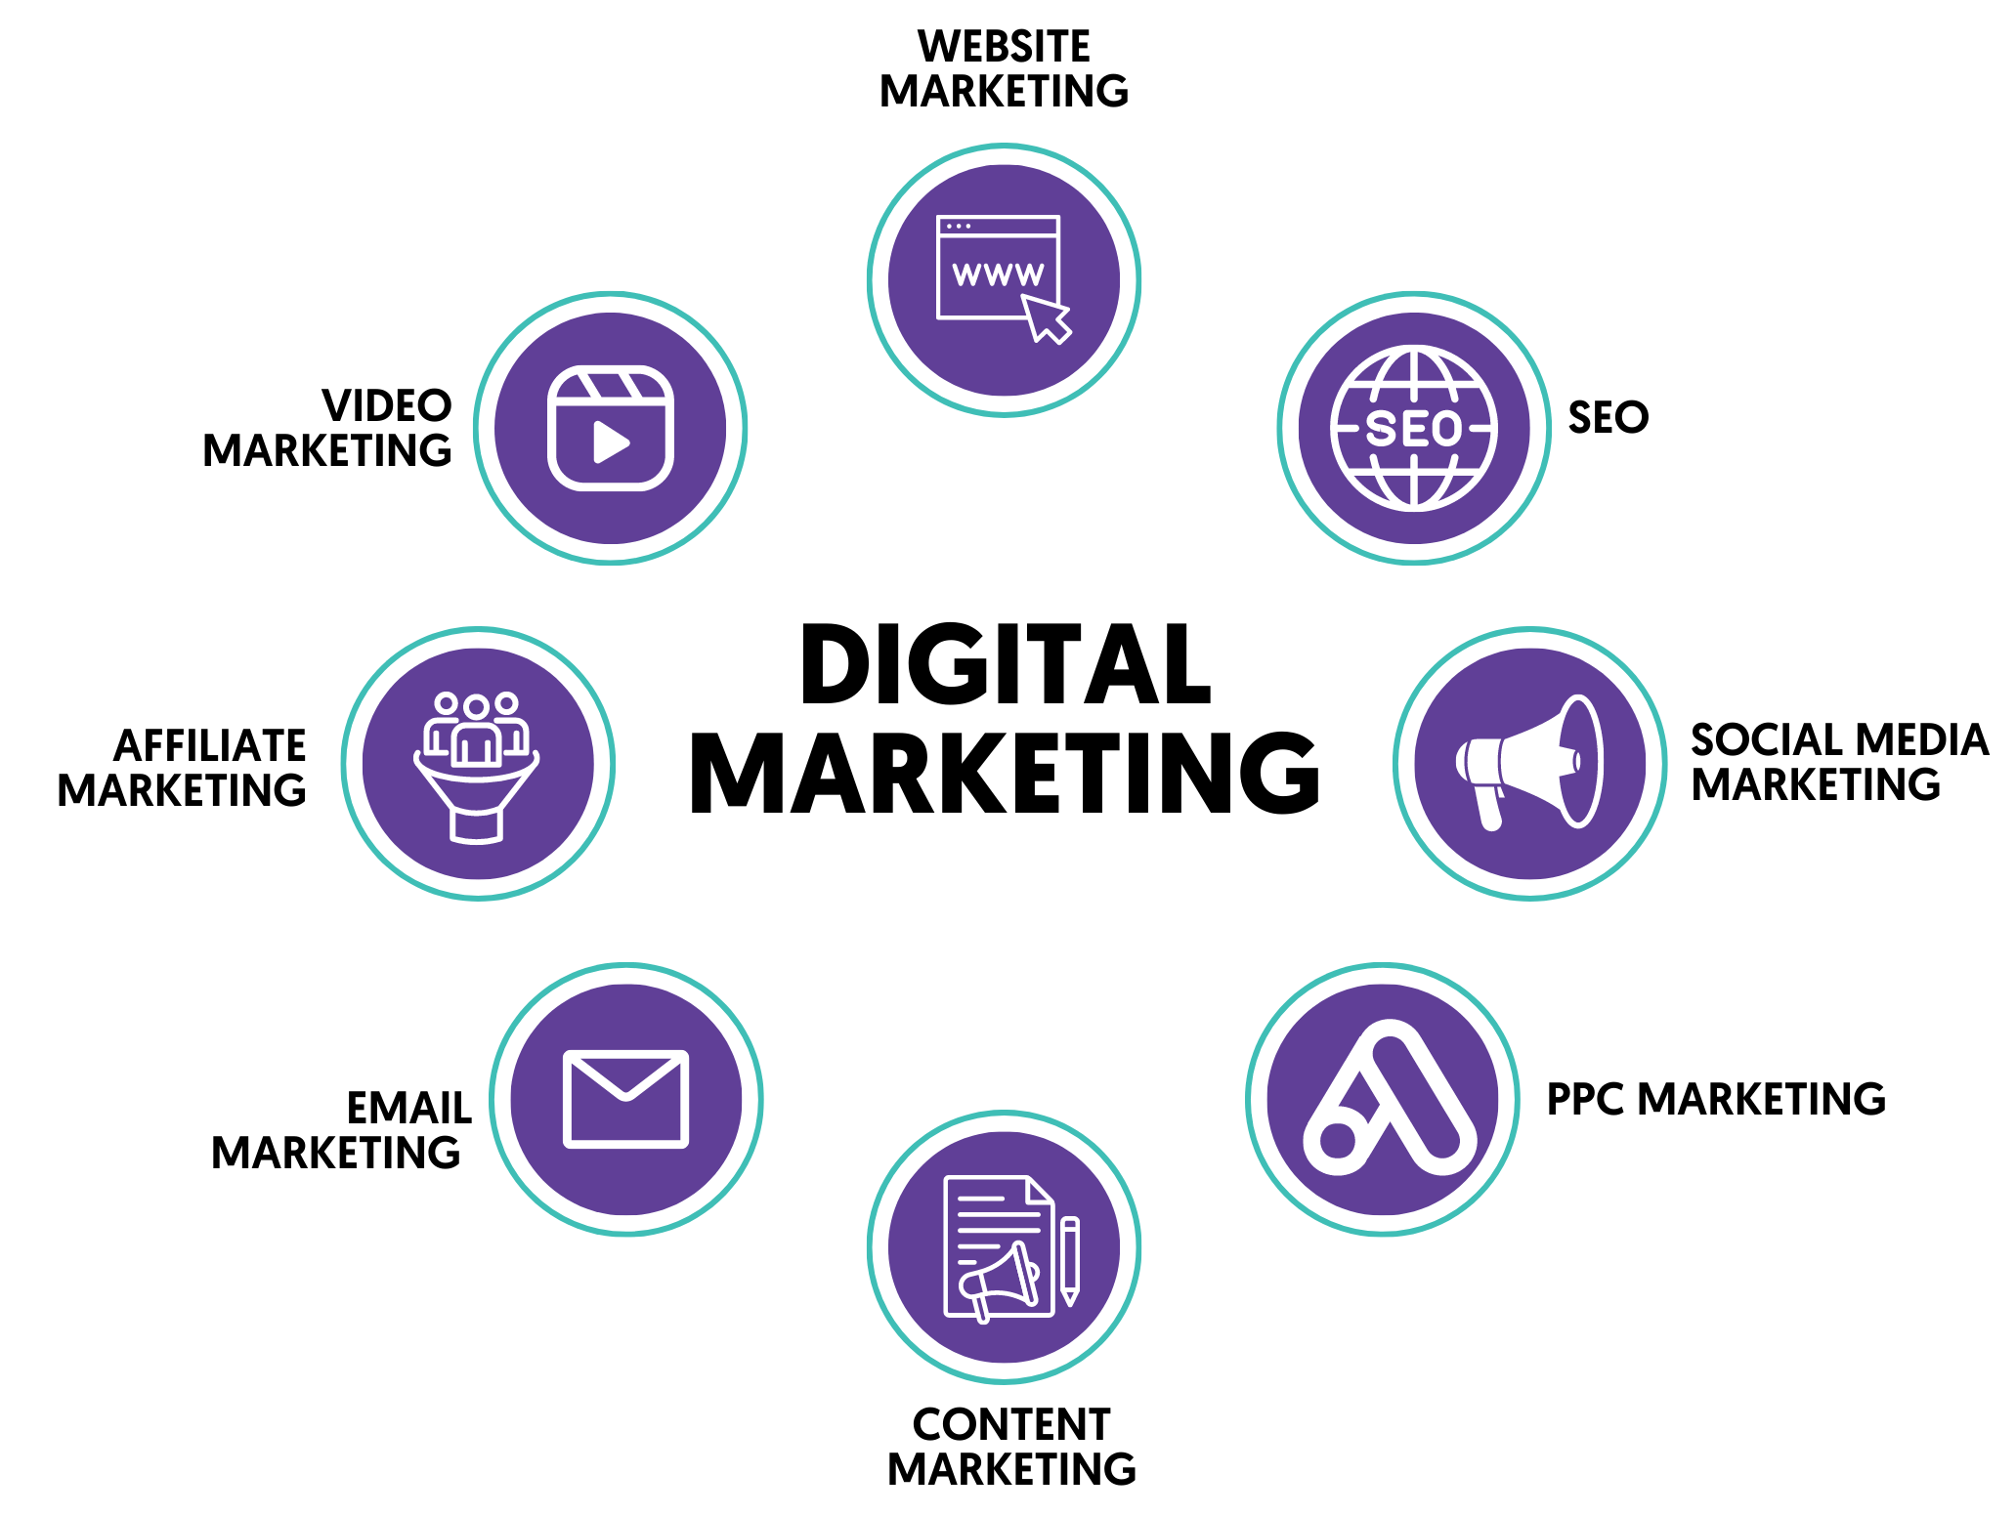
Digital Marketing Tactics

Slide 15
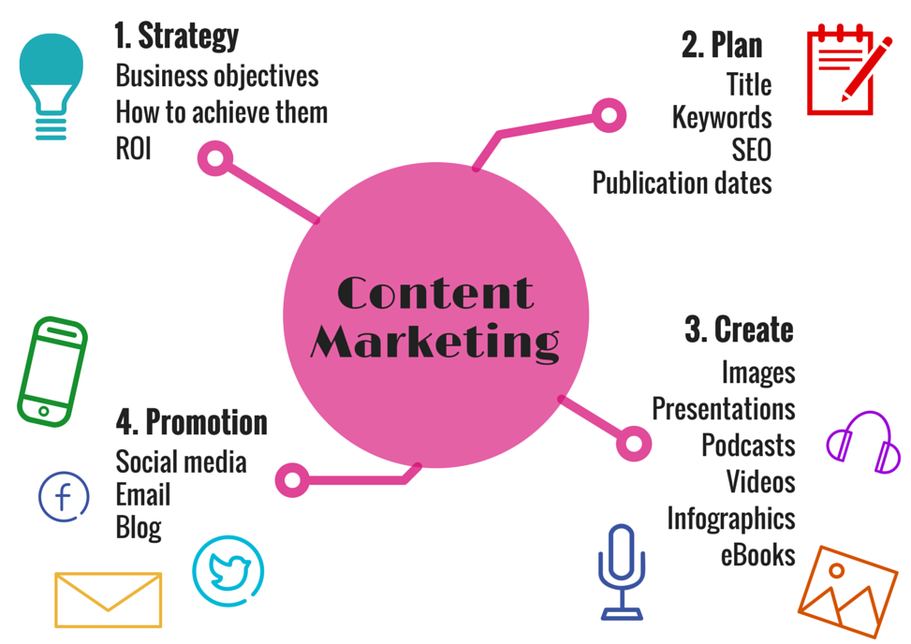
Content Marketing and Blogging
Attracting and engaging potential customers
Create a content marketing strategy that aligns with your business goals
Tips for creating high-quality, engaging blog posts that resonate with your target audience

Slide 16
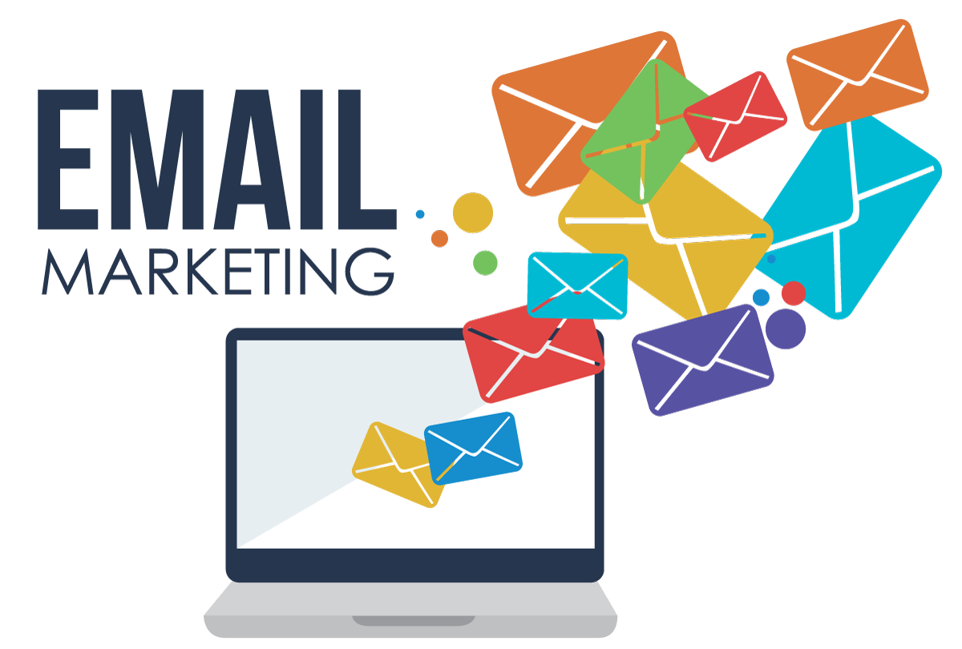
Email Marketing Campaigns
Building an email list and how to do it effectively
Strategies for creating successful email marketing campaigns that drive conversions
Tips for personalizing and segmenting your email campaigns to improve engagement

Slide 17

PR and Influencer Outreach
Public relations (PR) and its role in growing your customer base
Strategies for identifying and leveraging influencers in your industry to reach new audiences
Tips for crafting effective press releases and pitches that get noticed by media outlets

Slide 18
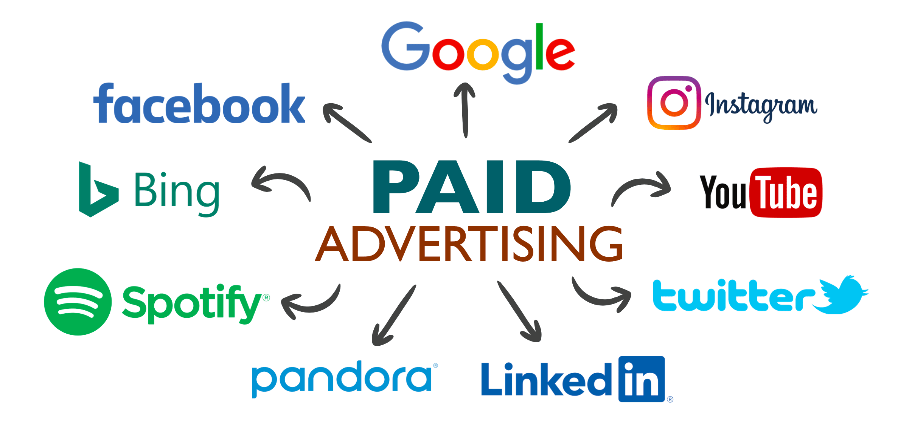
Paid Advertising

Slide 19
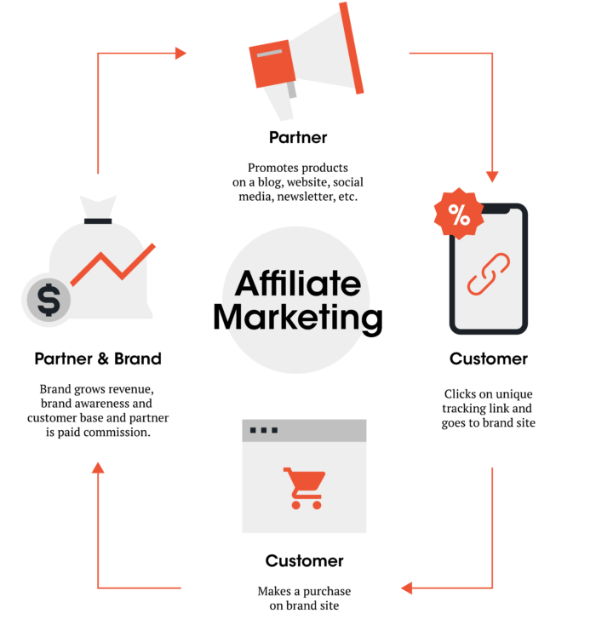
Partnerships and Affiliate Programs
Partnerships and affiliate programs as a means of expanding your customer base
Strategies for identifying and leveraging potential partnerships and affiliate opportunities

Slide 20
Onboarding and retaining customers

Slide 21

Customer Support Strategies
Customer support is crucial for retaining customers as it directly impacts their satisfaction and loyalty towards a company.
Email Support
Phone Support
Chat Support
FAQs and Knowledge Base

Slide 22
Customer Support Strategies
Strategies for providing effective customer support:
Prompt Response Times
Personalized Support
Empowering Customers with Self-Service Tools
Continuous Training for Support Agents
Gathering and Utilizing Customer Feedback

Slide 23
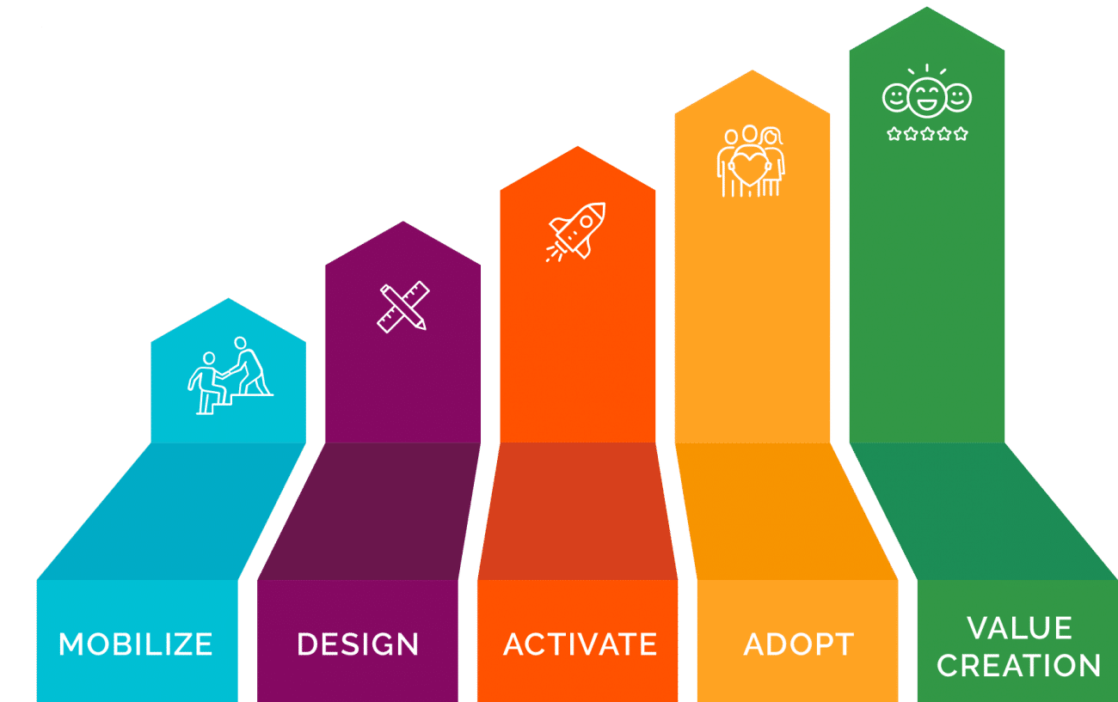
Post-Sales Onboarding Flow
Importance of onboarding customers after purchase:
Maximizing Product/Service Value
Minimizing Churn
Building Customer Loyalty

Slide 24
Post-Sales Onboarding Flow
Tips for ensuring customers are successfully onboarded:
Clear Communication
Timely Follow-ups
Personalized Assistance
Continuous Education
Monitor Customer Progress and Satisfaction

Slide 25
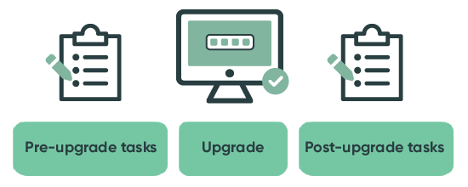
Implementing Upgrades/Updates
Importance of keeping your product up-to-date and relevant:
Competitive Advantage
Customer Satisfaction
Security and Stability

Slide 26
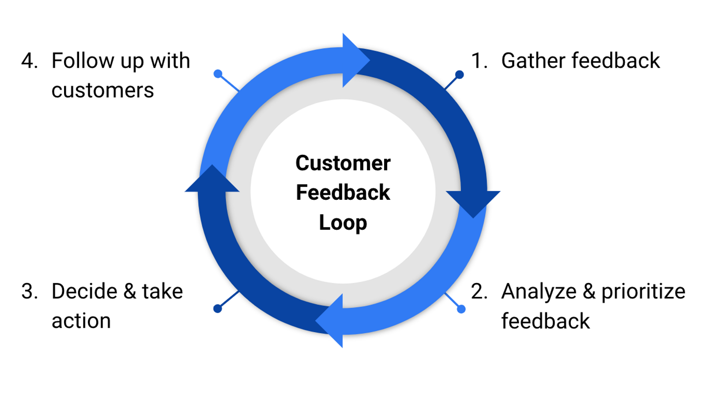
Implementing Upgrades/Updates
Tips for communicating upgrades and updates to customers:
Clear Messaging
Advance Notice
Training Resources
Release Notes
Two-Way Communication

Slide 27
Building Loyalty Programs
Importance of building customer loyalty
Strategies for creating effective loyalty programs (e.g. rewards, discounts, exclusive access)
Tips for making loyalty programs work for your business (e.g. personalized offers, tiered rewards, recognition of customer milestones)

Slide 28
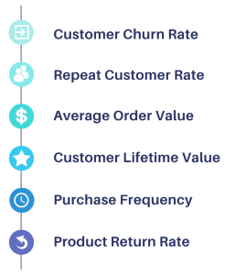
Customer Retention Metrics
Importance of tracking customer retention metrics
Business Sustainability
Customer Satisfaction and Loyalty
Revenue Growth

Slide 29
Scaling your business

Slide 30
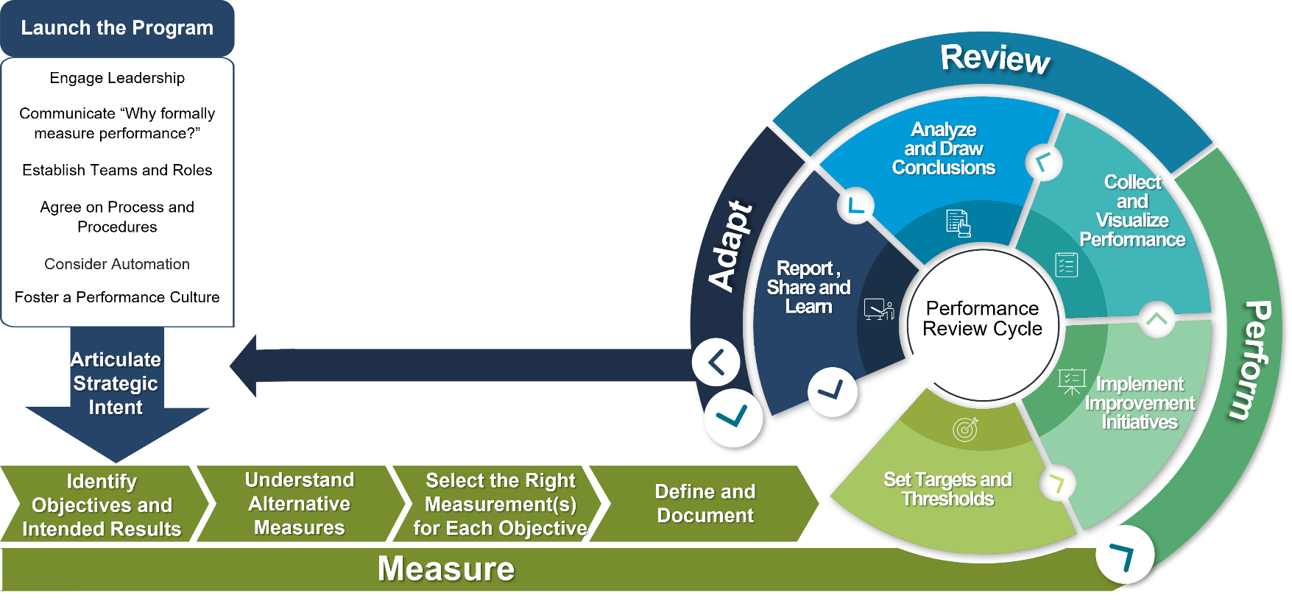
Analyzing Metrics and Key Performance Indicators
Importance of tracking and analyzing metrics for business growth:
Data-Driven Decision Making
Performance Evaluation
Optimization Opportunities

Slide 31
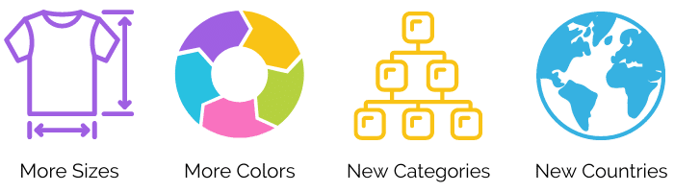
Expanding Product Offerings
Importance of expanding product offerings to grow the business:
Market Expansion
Competitive Advantage
Customer Retention and Upselling

Slide 32
Expanding Product Offerings
Strategies for identifying new product opportunities:
Customer Feedback
Market Research
Industry Experts and Partnerships

Slide 33
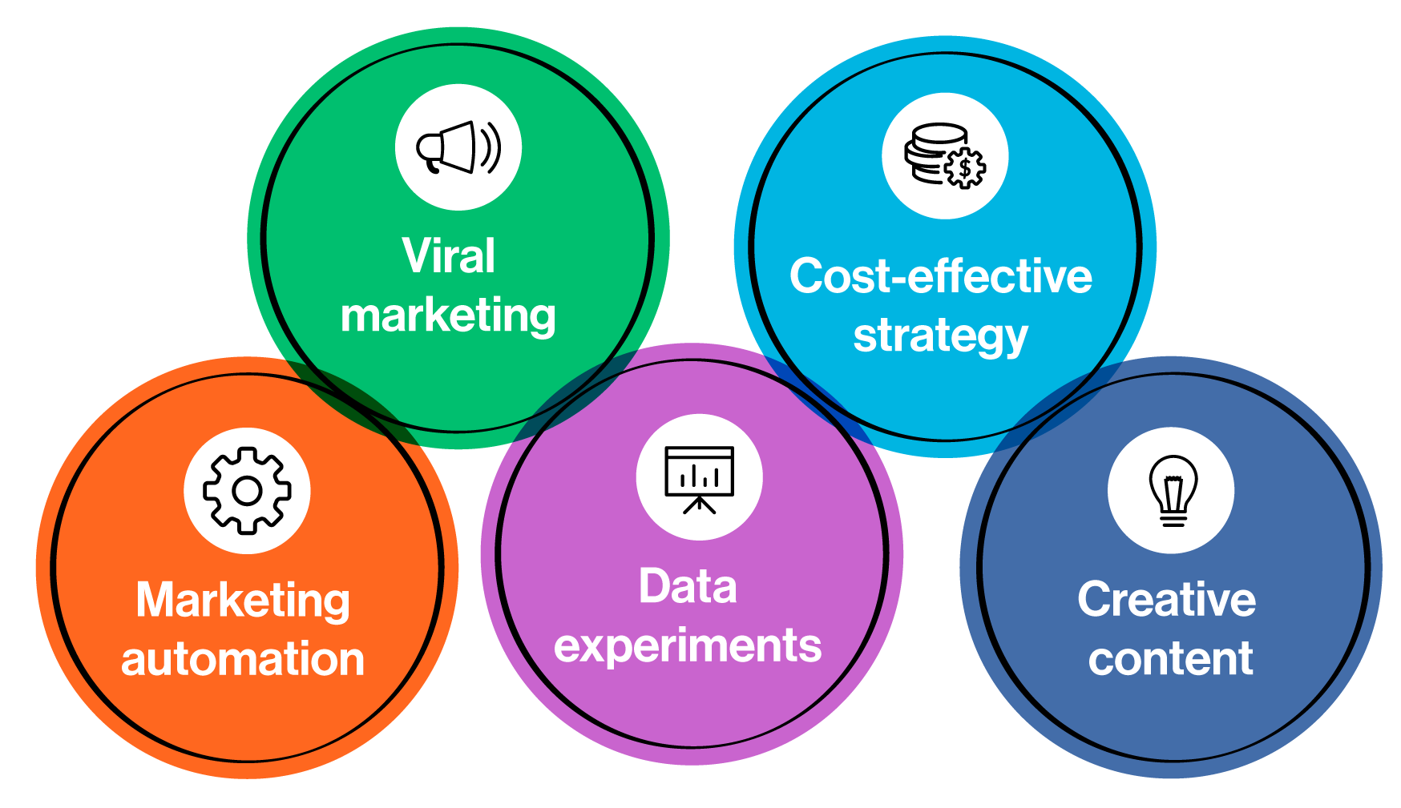
Growth Hacking Techniques
Growth hacking is particularly important in software entrepreneurship due to the digital nature of the business and the need for rapid user adoption.
Startups can leverage growth hacking techniques to gain initial traction, build a user base, and achieve exponential growth, even with limited resources.

Slide 34
Common challenges and lessons learned

Slide 35
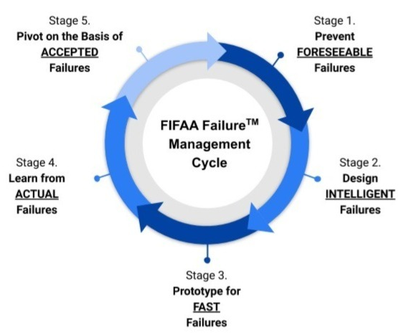
Handling Failures and Pivoting When Needed
Importance of embracing failure as a learning opportunity:
Growth and Innovation
Resilience and Adaptability
Continuous Improvement

Slide 36
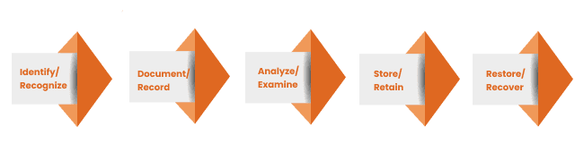
Handling Failures and Pivoting When Needed
Strategies for handling failures and learning from them:
Post-Mortem Analysis
Iterative Design
Feedback and Reflection
Growth Mindset

Slide 37
Successful pivots in software entrepreneurship
Twitter
Twitter initially started as a podcast platform called Odeo.
However, when Apple announced iTunes, which dominated the podcasting market, Odeo faced a significant challenge.
The team decided to pivot and focus on a new idea within the company, which eventually became Twitter.
This pivot led to tremendous success, transforming Twitter into one of the most popular social media platforms.

Slide 38
Successful pivots in software entrepreneurship
Instagram
Instagram began as a location-based social network called Burbn.
However, the founders noticed that the photo-sharing feature of Burbn was gaining more traction and engagement from users.
They decided to pivot and focus solely on photo-sharing, rebranding the platform as Instagram.
This pivot proved to be a game-changer, and Instagram became a leading photo and video-sharing app.

Slide 39
Successful pivots in software entrepreneurship
Slack
Slack initially started as a gaming company called Tiny Speck.
However, the company's game did not perform as expected.
The team shifted their focus and built a communication tool for internal use.
Recognizing its potential, they pivoted and rebranded as Slack, which eventually became a widely adopted team collaboration platform.

Slide 40
Legal and Compliance Considerations
Importance of understanding legal and compliance requirements for software startups
Common legal and compliance challenges faced by software entrepreneurs (e.g. intellectual property protection, data privacy)
Strategies for addressing these challenges (e.g. seeking legal advice, implementing compliance measures)

Slide 41
Competitive Analysis and Threats
Importance of conducting competitive analysis in software entrepreneurship
Strategies for identifying and analyzing competitors (e.g. market research, customer feedback)
How to respond to competitive threats (e.g. differentiating your product, improving customer service)

Slide 42
Potential Growth Barriers and Solutions
Common growth barriers faced by software startups (e.g. scalability, funding, talent acquisition)
Strategies for overcoming these barriers (e.g. leveraging cloud computing, seeking funding from venture capitalists, building a strong team culture)

